Slide 1

Python vs. C++

Slide 2
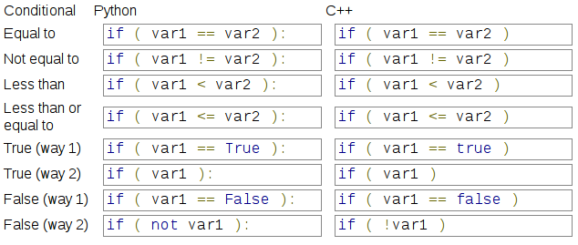
Conditional Statements
Conditional Statements

Slide 3
Conditional Statements
Linking Conditional Statements together
  Are two (or more) statements true? Is one true and one false? Are both false?
Python
if ( age > 18 and age < 21 ):
print( "You can vote, but you cannot drink!" )
if ( grade == "F" or grade == "D" ):
print( "You failed :(" )
C++
if ( age > 18 && age < 21 )
{
cout << "You can vote, but you cannot drink!" << endl;
}
if ( grade == "F" || grade == "D" )
{
cout << "You failed! :(" << endl;
}

Slide 4
Conditional Statements
Conditional Statements are used both for If Statements, and Loops.
They always are either True or False

Slide 5
If Statements
Python uses if, elif, and else.
C++ uses if, else if, and else.
Python
if ( balance < 0 ):
print( "You owe money!" )
elif ( balance == 0 ):
print( "You have no money in your account" )
else:
print( "How much would you like to withdraw?" )

Slide 6
If Statements
Python uses if, elif, and else.
C++ uses if, else if, and else.
C++
if ( balance < 0 )
{
cout << "You owe money!" << endl;
}
else if ( balance == 0 )
{
cout << "You have no money in your account" << endl;
}
else
{
cout << "How much would you like to withdraw?" << endl;
}

Slide 7
Switch Statements
C++ also has Switch Statements, which work specifically with integers.
Switch statements only check for whether an int variable equals a value; won't do < or > checks.

Slide 8
Switch Statements
cout << "Choose a menu option:" << endl;
cout << "1. Play game" << endl;
cout << "2. View Help" << endl;
cout << "3. Quit" << endl;
int choice;
cin >> choice;
switch( choice )
{
case( 1 ):
PlayGame(); // Function call
break;
case( 2 ):
DisplayHelp(); // Function call
break;
case( 3 ):
return 0; // Quit program
break;
default:
cout << "Invalid option!" << endl;
break;
}

Slide 9
Switch Statements
switch( nextLevel )
{
case 5:
rank = “Adventurer”;
score += 50
break;
case 10:
rank = “Knight”
case 11:
score += 100
break;
default:
score += 10
break;
}
The switch statement encloses the entire behavior based on the variable's value.
Can contain case statements and a default value. Default is executed if none of the case statements match the variable's value.

Slide 10
Switch Statements
switch( nextLevel )
{
case 5:
rank = “Adventurer”;
score += 50
break;
case 10:
rank = “Knight”
case 11:
score += 100
break;
default:
score += 10
break;
}
Break is put at the end of the case condition.
break;
If break; isn't added, then the program will also execute the code in the case statement immediately below.
This may be something you want in some cases.

Slide 11
Nesting If Statements
You can “Nest” blocks of code like if statements or loops within other if statements and loops.
if ( playerAlive == True ):
if ( state == "battle" ):
print( "A: Attack" )
print( "B: Block" )
print( "D: Dodge" )
print( "R: Run away" )
elif ( state == "navigating" ):
print( "N: North" )
print( "S: South" )
print( "E: East" )
print( "W: West" )
input( "What will you do next?" )
else:
print( "Game Over" )

Slide 12
Nesting If Statements
if ( playerAlive == True ):
if ( state == "battle" ):
print( "A: Attack" )
print( "B: Block" )
print( "D: Dodge" )
print( "R: Run away" )
elif ( state == "navigating" ):
print( "N: North" )
print( "S: South" )
print( "E: East" )
print( "W: West" )
print( "What will you do next?" )
choice = input( "? " )
else:
print( "Game Over" )
if ( playerAlive == true ) {
if ( state == "battle" ) {
cout << "A: Attack" << endl;
cout << "B: Block" << endl;
cout << "D: Dodge" << endl;
cout << "R: Run away" << endl;
}
else if ( state == "navigating" ) {
cout << "N: North" << endl;
cout << "S: South" << endl;
cout << "E: East" << endl;
cout << "W: West" << endl;
}
cout << "What will you do next?\n? ";
cin >> choice;
}
else {
cout << "Game Over" << endl;
}

Slide 13
If Statements
Additional Reading
  http://www.cplusplus.com/doc/tutorial/control/
  http://www.learncpp.com/cpp-tutorial/52-if-statements/

